Slide 1
Class 9: Linear Regression 3
MGSC 310
Ben Labaschin

Slide 2
Class 9: Outline
Categorical Variables and Modeling
Predicted vs True Plots
Median and Mean Absolute Error
Interpreting Log-Log Coefficients
Polynomial Variables in a Regression
Regression Lab

Slide 3
Categorical (Encoded) Variables and Modeling
Categorical Variables in Modeling
Definition: Variables that can take on a limited, fixed number of values. Examples include colors (red, blue, green), gender (male, female), and ratings (low, medium, high).
Importance:
Richness in Data: Captures non-numeric information … numerically!
Domain Insights: Represents data from far more domains (most of the internet is text data!)

Slide 4
Handling Encoded Data for Modeling (½)
Label Encoding:
Assign a unique integer to each category.
Useful for ordinal data.
Careful! Imputes a relationship between numbers that may not exist.
Example: Sizes: Small (1), Medium (2), Large (3).
One-Hot (Dummy) Encoding:
Convert categories into binary columns.
Careful! Can explode the number of variables in a dataframe.
Example: Colors: Red -> is_red (0 or 1), Blue -> is_blue (0 or 1).
Binary Encoding:
Combine features of both label and one-hot encoding.
Categories are first labeled and then converted to binary code.
Example: Colors: Red (001), Blue (010), Green (011).

Slide 5
Handling Encoded Data for Modeling (2/2)
Frequency (or Count) Encoding:
Replace categories with their frequency or count.
Careful! You may not be able to aggregate data in production.
Example: Cities: NYC (1000), LA (750), Chicago (500).
Target (Mean) Encoding:
Replace categories with the mean of the target variable for that category.
Careful! Means are highly influenced by large outliers.
Example: Car Brands: Toyota (avg price $20k), Ford (avg price $25k).
Embedding Layers (Deep Learning):
Map categories to dense vectors.
Careful! Embeddings may not express relationships that you think.
Example: Movie Genres: Action ([0.2, 0.5, 0.7]), Drama ([0.9, 0.1, 0.3]).

Slide 6
To the code!
Access to the code for encoding prediction!

Slide 7
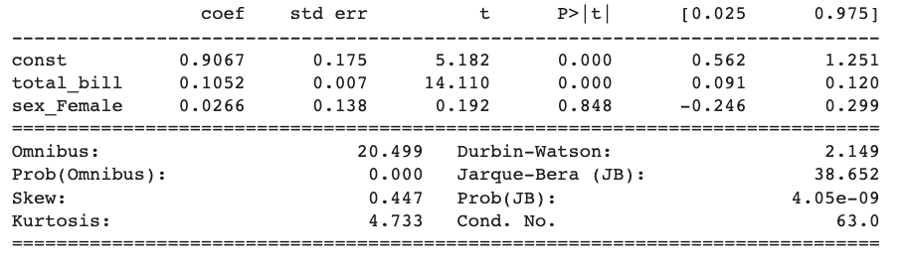
Interpreting Coefficients of Encoded Data in Linear Regression (1/2)
NOTE! This data is made up by the creators of Seaborn and should not be interpreted as “factual” in any way.
Coefficients:
const: The constant (or intercept) is 0.9067 units. This represents the expected tip amount when the total bill is zero and the tipper is male (because when sex_Female is 0, the tipper is male).
Take-Away: At the intercept, the coefficient represents the what the categorical variables aren’t.
total_bill: For every one-dollar increase in the total bill, the tip amount is expected to increase by about 0.1052 cents, holding the sex constant (ceteris paribus).
sex_Female: The coefficient for sex_Female is 0.1291 units. This means that, on average, tips given by females are higher by about 0.1291 units than those given by males, holding the total bill constant.
BUT these results are not statistically significant! We cannot reject the null-hypothesis.

Slide 8
Interpreting Coefficients of Encoded Data in Linear Regression (2/2)
Take-Away:
The coefficient for a categorical variable in a regression model tells us the difference in the mean response between the reference category (in this case, male) and the given category (in this case, female), holding other variables constant. A negative coefficient indicates that the given category (female) has a lower mean response compared to the reference category.
Always check the p-values of coefficients to gauge their statistical significance. A low p-value (typically ≤ 0.05) suggests the predictor variable has a statistically significant relationship with the dependent variable.
Access to the code for encoding prediction!

Slide 9
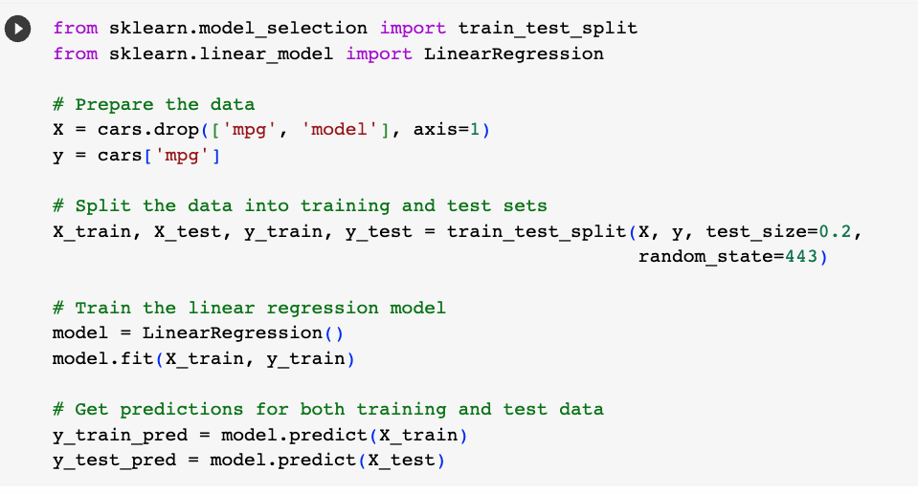
Predicted True Plots
Plotting predicted observations on the Y axis with true observations on X axis is a useful diagnostic tool
First we must create predict on our train and test data.

Slide 10
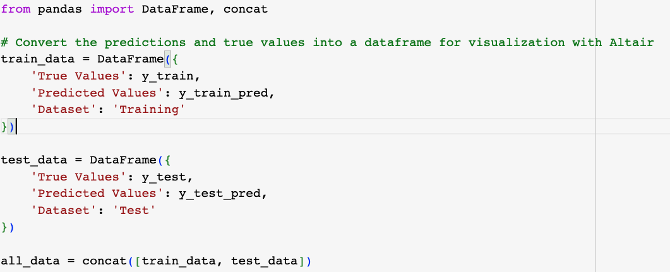
Predicted True Plots
Then create a dataframe of our predictions!

Slide 11
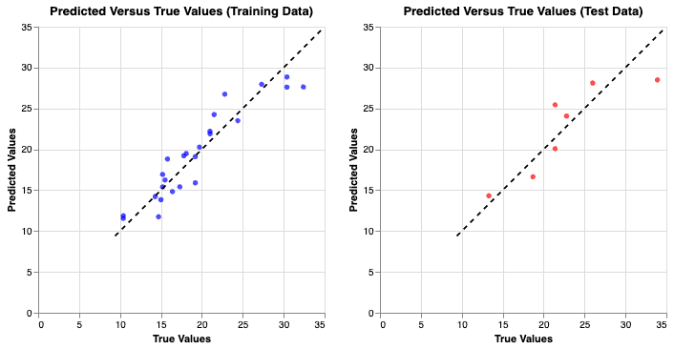
Predicted True Plots
A perfect linear model has data aligned along the diagonal
In general we want to ensure our predictions do not systematically deviate above or below the line for certain ranges of the variable we are predicting
I.e. we don’t want to under/overpredict for big/small values of Y
Access to the code for true plot creation!

Slide 12
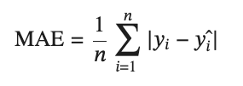
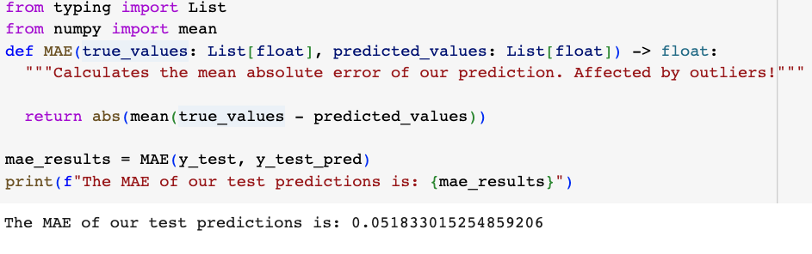
Mean Absolute Error (MAE)
Mean Absolute Error (MAE) represents the average of the absolute differences between the predicted and actual values.
MAE cares about outliers, since it calculates the average over all errors
MAE represents the average of the absolute differences between the predicted and actual values.

Slide 13
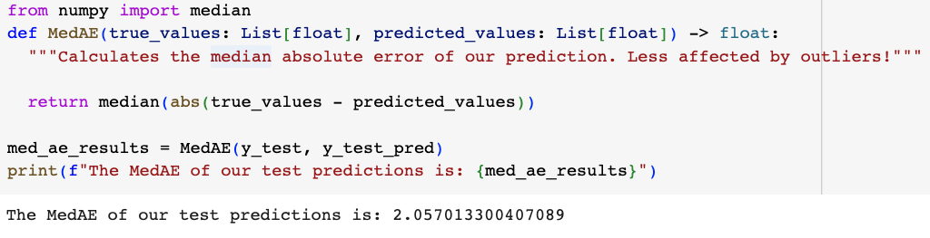
Median Absolute Error (MedAE)
MedAE represents the median of the absolute differences between the predicted and actual values.
MedAE cares less about extreme errors for outliers and more about the error for the median observation

Slide 14
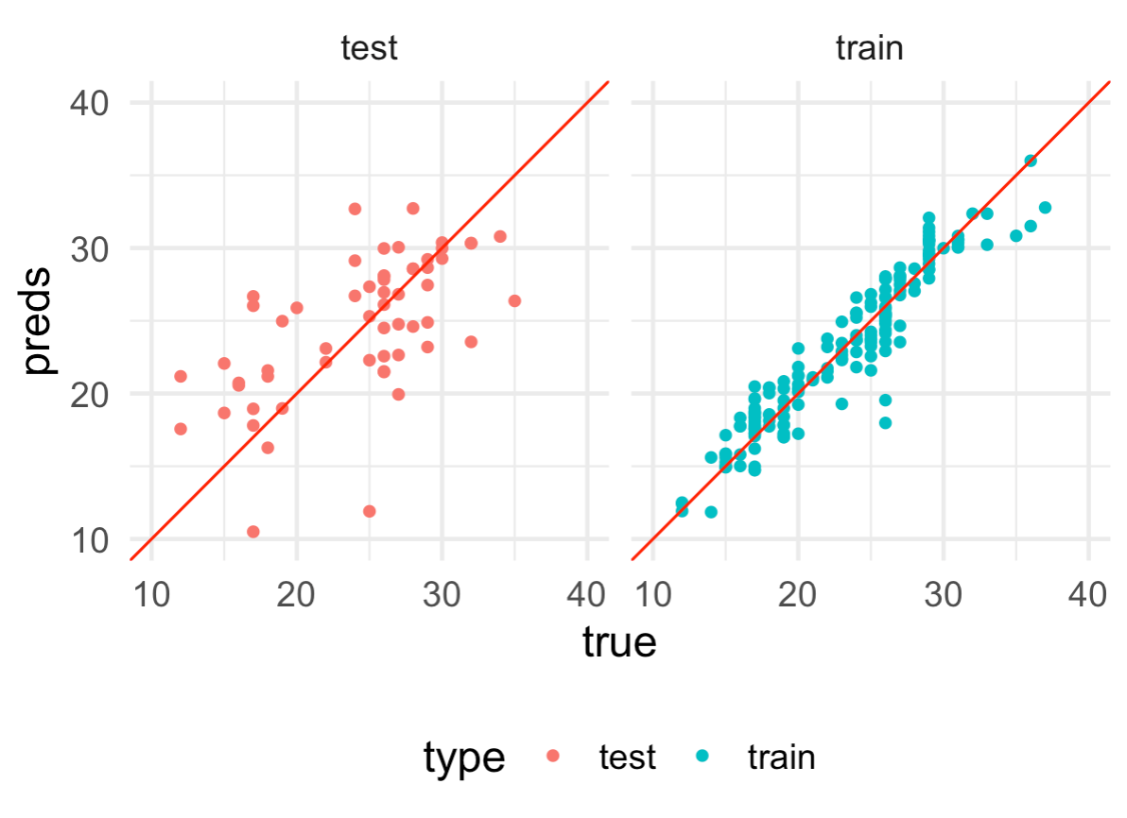
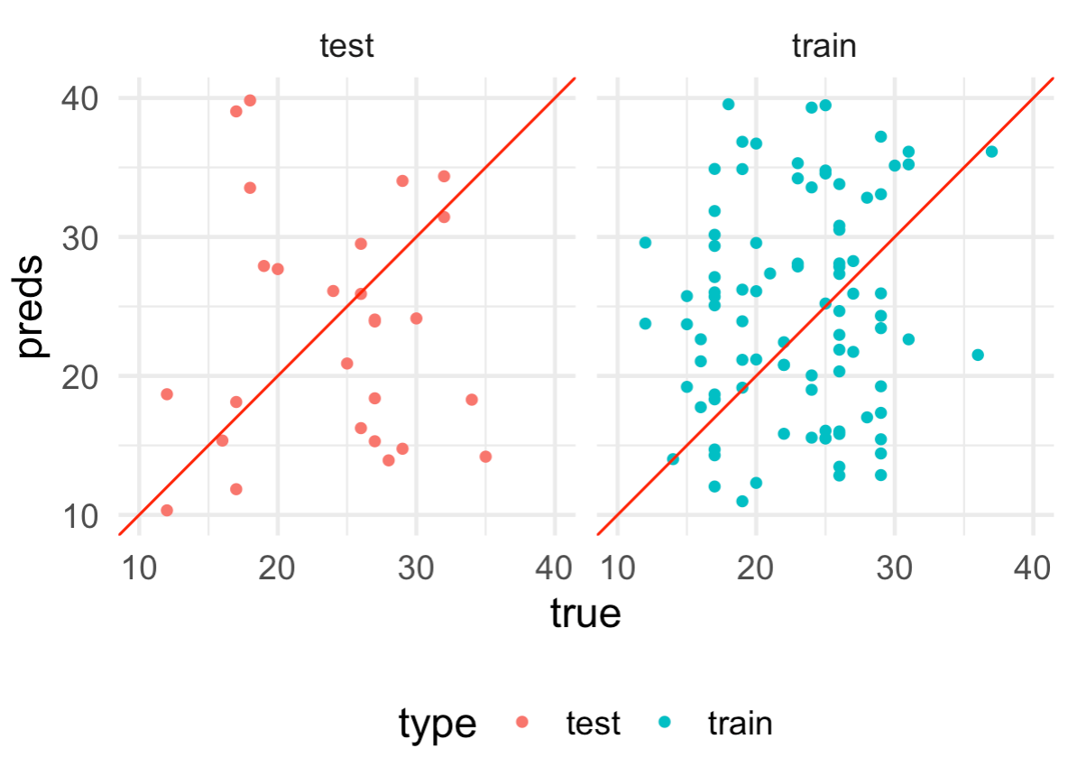
Underfit vs Overfit (Solutions)
Overfit: model looks really good in the training set but bad in the test set
Underfit: model looks bad in both train and test.
Solution: reduce model complexity. (Use fewer variables, simpler model.)
Solution: Increase model complexity. (Use more variables, more complex model, e.g. neural net.)

Slide 15
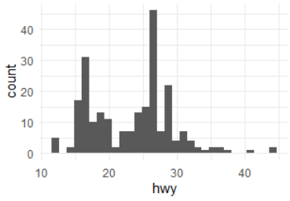
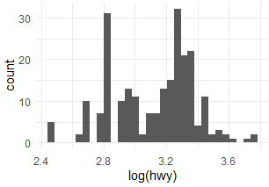
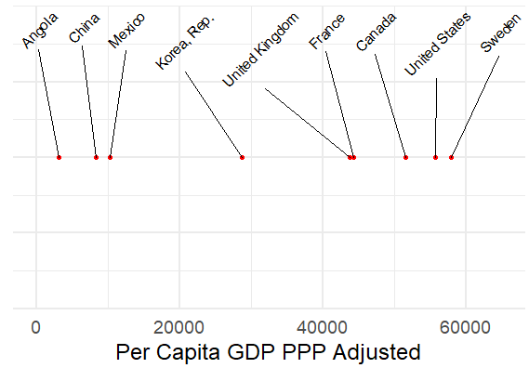
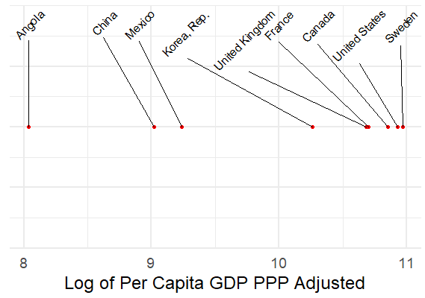
Why Log Transformations For Regression Data
Log transforming our data is often very useful if our data is particularly “spread out”
In particular if there are outlier values this will improve model performance
Some data like income should usually be logged
Model accuracy often improves when logging dependent variable but interpretation can suffer

Slide 16

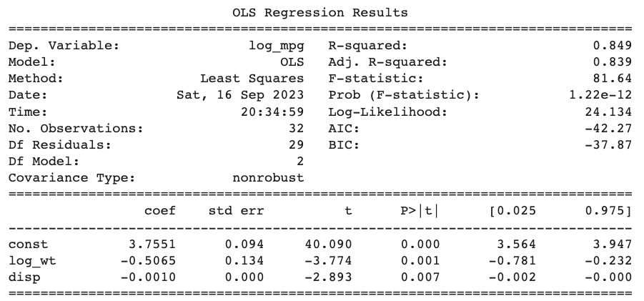
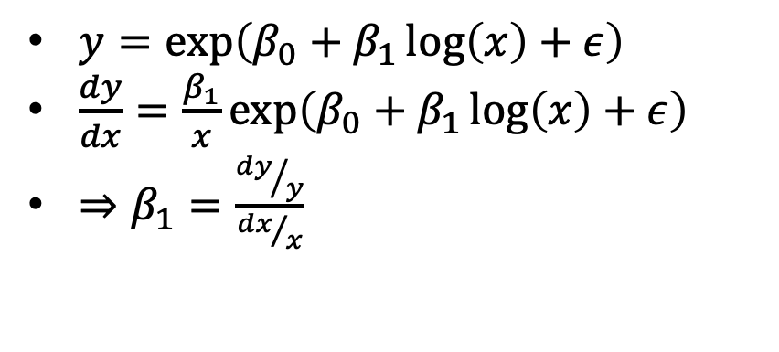
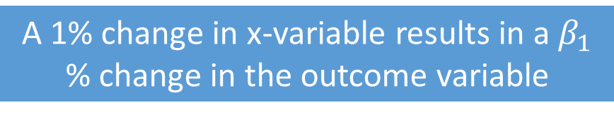
Log-Log Regression Model Coefficients = Elasticities!
Suppose we log our mpg regression model
How do we interpret the log of wt?
Therefore log coefficients can be interpreted as elasticities!
Here a 1% increase in displacement equals a 0.50% decrease in highway mpg.

Slide 17
Note on Interpreting Log-* and *-Log Regression Model Coefficients
KNOW THIS
Log-Linear Regression (Logged Dependent, Non-Logged Independent)
Interpretation: A one-unit increase in the independent variable is associated with a β×100% change in the expected value of the dependent variable, holding all else constant.
Multiply coefficient by 100.
Linear-Log Regression (Non-Logged Dependent, Logged Independent)
Interpretation: A 1% increase in the independent variable is associated with a β unit change in the expected value of the dependent variable, holding all else constant.
No multiplication by 100, but read independent variable as percent
Log-Log Regression (Both Dependent and Independent are Logged)
Interpretation: A 1% increase in the independent variable is associated with a
β percentage change in the expected value of the dependent variable, holding all else constant.
No multiplication by 100, read both variables as percent

Slide 18
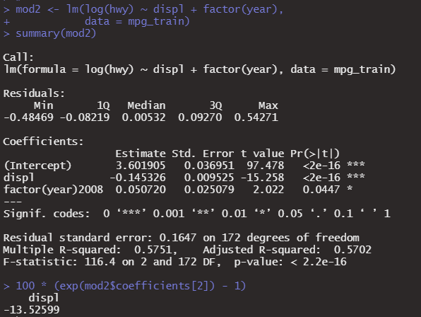

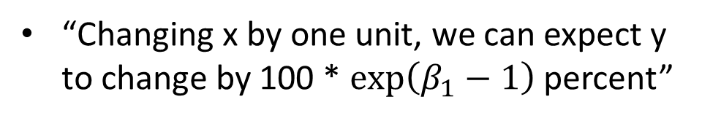
Log-Linear Regression Model Coefficients
Log Y and linear X variables have a special interpretation as well according to the equation:
Here if we change displacement by one liter we can except highway miles per gallon to decrease by 13.5 percent.
Note this is very close to a unit change in X -> coefficient % change in Y.

Slide 19
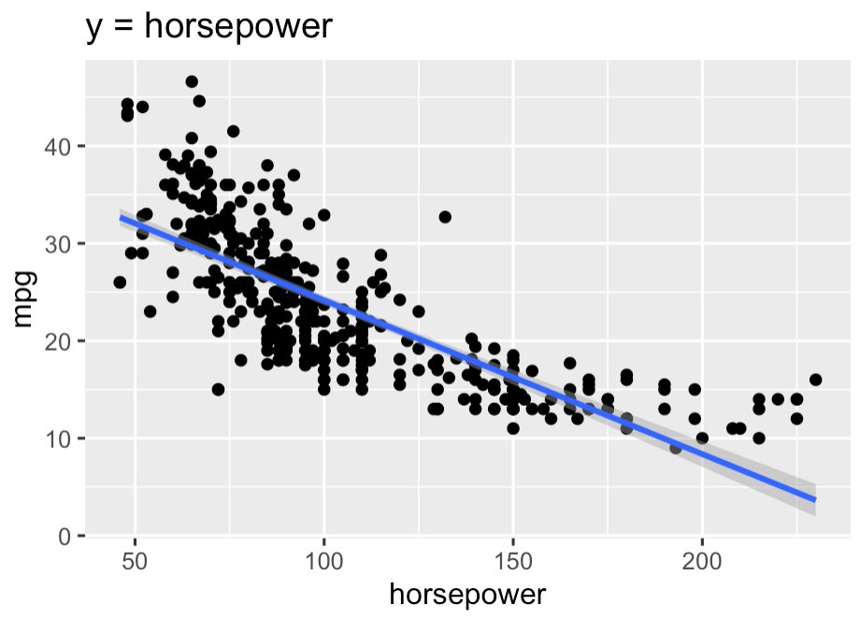
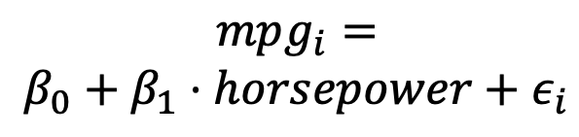
Interpreting horsepower as a linear impact on mpg
The impact of horsepower on mpg is constant for any value of horsepower

Slide 20
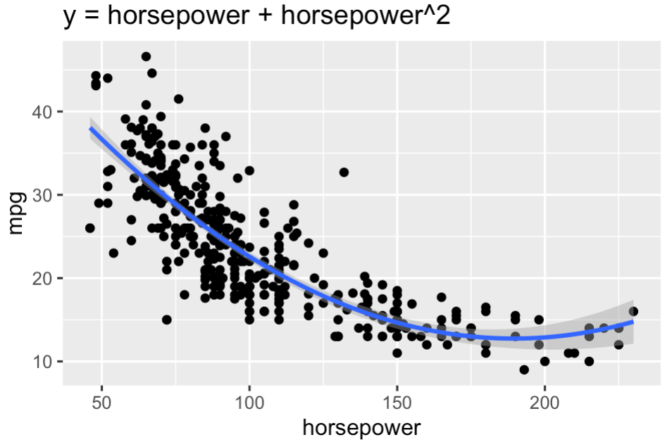
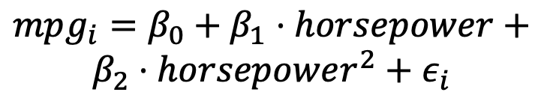
Interpreting horsepower as a non-linear impact on mpg
The impact of horsepower on mpg depends on a particular value of horsepower
Impact of horsepower on mpg is positive but diminishes as horsepower increases
Aka first derivative is positive, and second derivative (rate of change) is negative

Slide 21
Why Retain Linear and non-linear horsepower? (Hierarchical Model Specification)
We always include both the polynomial and original variable in our regression to capture the relationship between the independent and dependent variables.
The linear variable represents the change in the mean of mpg for a one-unit change in horsepower. Horsepower-squared (non-linear variable) represents the rate of change in the slope as horsepower increases.
In linear regression, always include your polynomial variables up to the highest polynomial. e.g. if you do hp⁵, you would include hp⁴, hp³, hp², and hp.
This is called hierarchical model specification.

Slide 22
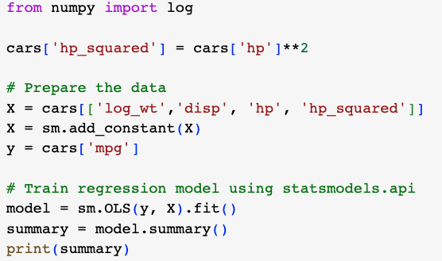
Engineering Squared Features

Slide 23
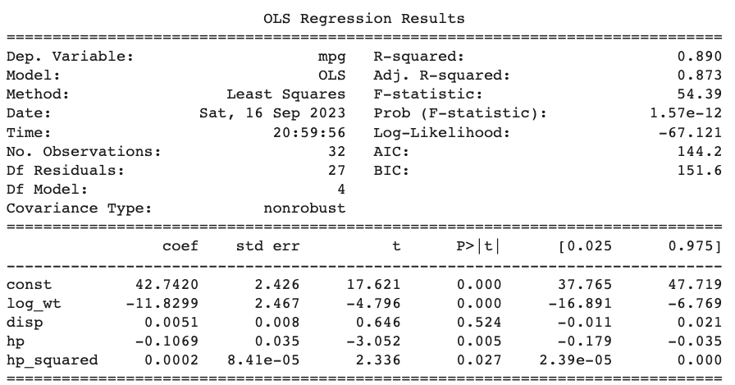
Interpreting a
Nonlinear model
Coefficients:
const: The constant (or intercept) is 42.742 units (mpg). The intercept represents the baseline mpg when considering the average values of other predictors.
hp: For every one-unit increase in a vehicle’s horsepower capacity, mpg is expected to decrease -0.1069 units, holding all else constant (ceteris paribus).
hp_squared: The positive coefficient for hp_squared suggests that the decline in mpg due to an increase in horsepower becomes slower as horsepower increases. Specifically, for each additional unit of horsepower, the rate of decrease in mpg diminishes by 0.0002 units.
These results are statistically significant! We can reject the null-hypothesis.

Slide 24
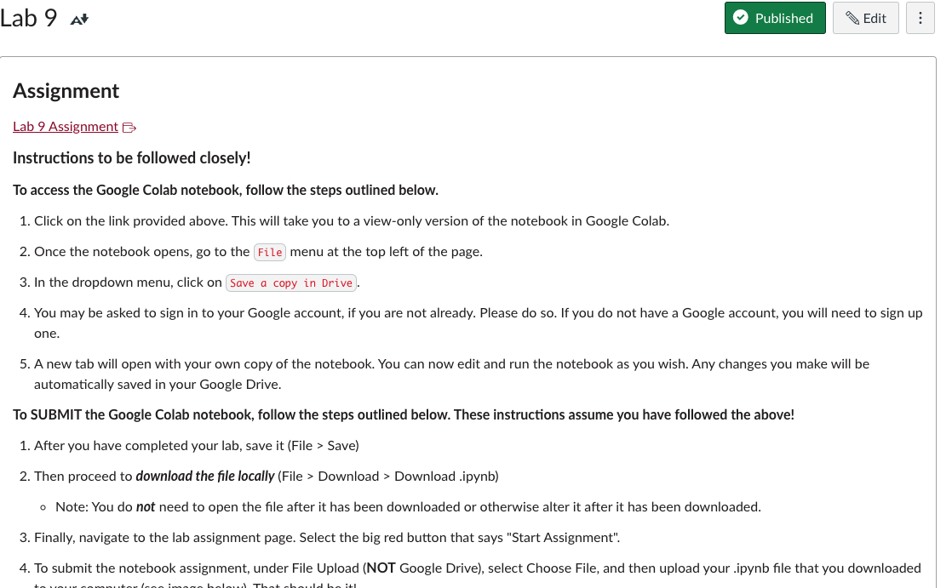
Lab 9

